Slide 1
Preaching and the Presence of Christ
Nightcliff Uniting Church, 27-28 February 2018

Slide 2
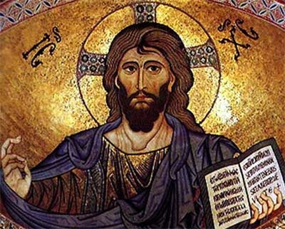

Slide 3
The Uniting Church acknowledges that the Church is able to live and endure through the changes of history only because its Lord comes, addresses, and deals with people in and through the news of his completed work. Christ who is present when he is preached among people is the Word of the God who acquits the guilty, who gives life to the dead and who brings into being what otherwise could not exist. Through human witness in word and action, and in the power of the Holy Spirit, Christ reaches out to command people’s attention and awaken faith; he calls people into the fellowship of his sufferings, to be the disciples of a crucified Lord; in his own strange way Christ constitutes, rules and renews them as his Church.
The Basis of Union, paragraph 4

Slide 4
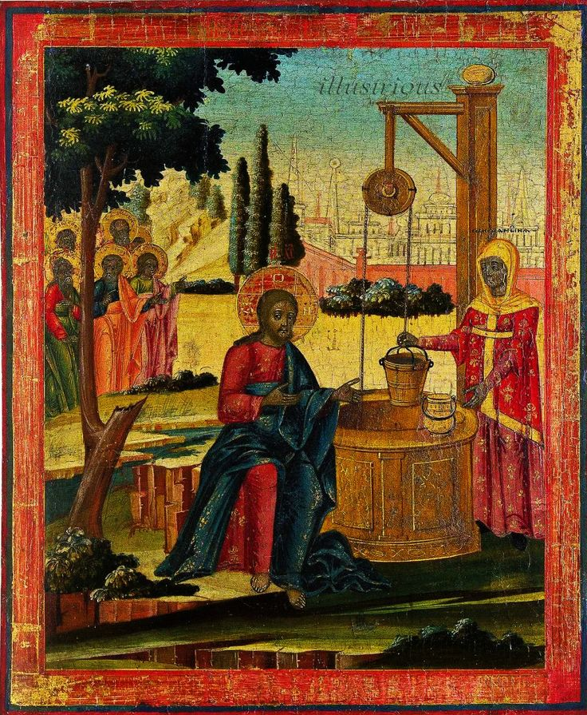

Slide 5
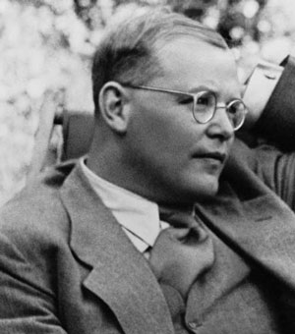
Dietrich Bonhoeffer
“The proclaimed word is the incarnate Christ himself… it is the Christ himself walking through his congregation as the Word.”

Slide 6
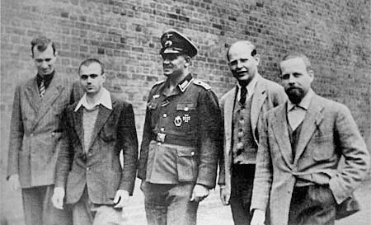
Dietrich Bonhoeffer
“I accompany the text along its own way into the congregation … This permits the Word’s almost magnetic relationship to its congregation. I do not give life to it, but it gives life to me and to the congregation. The movement of the Word to its congregation is accomplished through the interpretation of it.”

Slide 7
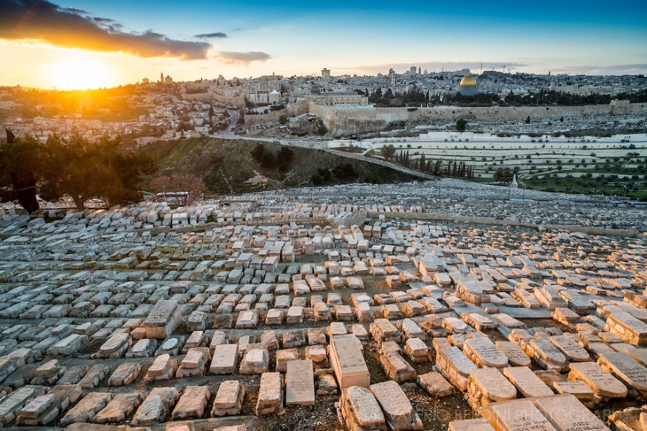

Slide 8
The Uniting Church acknowledges that the Church is able to live and endure through the changes of history only because its Lord comes, addresses, and deals with people in and through the news of his completed work. Christ who is present when he is preached among people is the Word of the God who acquits the guilty, who gives life to the dead and who brings into being what otherwise could not exist. Through human witness in word and action, and in the power of the Holy Spirit, Christ reaches out to command people’s attention and awaken faith; he calls people into the fellowship of his sufferings, to be the disciples of a crucified Lord; in his own strange way Christ constitutes, rules and renews them as his Church.
The Basis of Union, paragraph 4

Slide 9
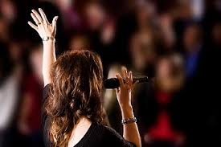
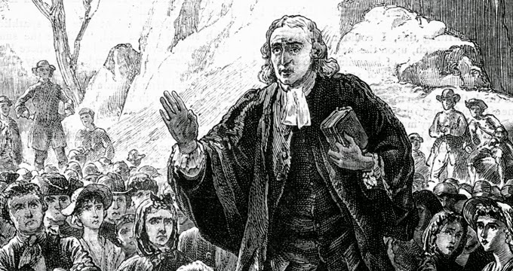
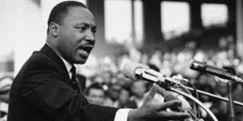
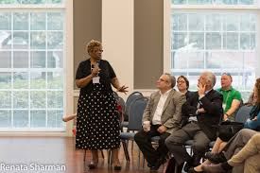
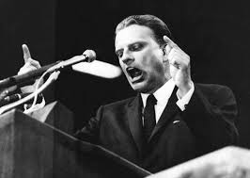

Slide 10
The Uniting Church acknowledges that the Church has received the books of the Old and New Testaments as unique prophetic and apostolic testimony, in which it hears the Word of God and by which its faith and obedience are nourished and regulated. When the Church preaches Jesus Christ, its message is controlled by the Biblical witnesses. The Word of God on whom salvation depends is to be heard and known from Scripture appropriated in the worshipping and witnessing life of the Church. The Uniting Church lays upon its members the serious duty of reading the Scriptures, commits its ministers to preach from these and to administer the sacraments of Baptism and the Lord's Supper as effective signs of the Gospel set forth in the Scriptures.
Basis of Union, paragraph 5

Slide 11
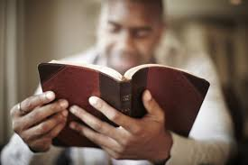
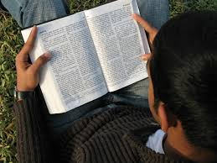
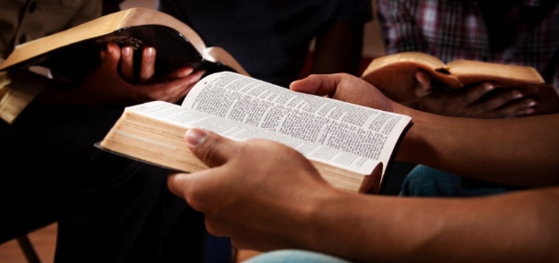

Slide 12
